Slide 1
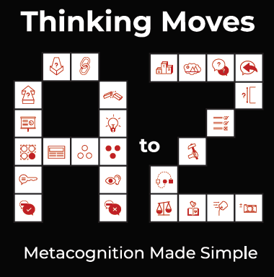
Individual Moves
A – Z
Taster Pack

Slide 2
Contents
Overview of Thinking Moves
Introduction to the six taster moves
Selection of slides from the Thinking Calendar

Slide 3
These slides are a small subset (5%) of the full range of our Thinking Moves resources.
The Thinking Moves Calendar and our premium resources cover all 26 Thinking Moves in detail with activities, exercises and curriculum suggestions for all age ranges.
Please go to https://dialogueworks.co.uk/thinking-moves-a-z-premium-resources/ to access the full set of resources.

Slide 4
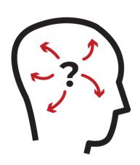
Thinking Moves A – Z: what?
Thinking Moves provides a vocabulary of
26 fundamental thinking processes.
Thinking
Moves
A - Z
Comprehensive
Comprehensible
Memorable
If students can master these processes, to the point where they can
not only recognise them but also apply them independently and effectively,
they will be metacognitive learners.

Slide 5
Metacognition is powerful but challenging
7 months additional progress
Particularly effective for low achieving and older students
Best learned collaboratively
But it’s hard to teach metacognitively
Thinking Moves makes metacognition simple

Slide 6
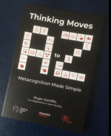
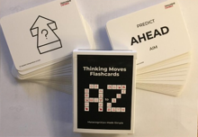
DialogueWorks offers training and implementation support
Training
Become familiar with Thinking Moves A – Z
Understand how to build Thinking Moves into the curriculum
Understand how Thinking Moves can enrich inquiry based learning
Get practical guidance on how to embed Thinking Moves into your school’s teaching and learning
Webinars
Four sessions
Online resources
£125 per person
Handbook
Posters and Cards
£10
£10
INSET
Full day or three twilights
Online resources
Up to 25 staff
£1,000 - £1,250
Thinking Calendar
Fortnightly online teaching packs covering linked pairs of Thinking Moves
For information and bookings, contact:
bobhouse@dialogueworks.co.uk
https://dialogueworks.co.uk/thinking-moves/
£125 pa

Slide 7
Contents
Overview of Thinking Moves
Introduction to the six taster moves
Selection of slides from the Thinking Calendar

Slide 8
Three fundamental Thinking Moves
Think AHEAD
Think BACK
LOOK/LISTEN

Slide 9
Three other fundamental Thinking Moves
CONNECT
DIVIDE
ZOOM (In / Out)

Slide 10
Think AHEAD
Predict
Aim
What are you aiming for?
What do you think will happen?

Slide 11
Activity: What would happen then?
Imaginative story-telling game
Think AHEAD through chains of predictions
Pause occasionally to recap
Break into pairs to generate new ideas
What would happen if you were invisible?
You’d be lonely because nobody could see you
What would happen because of that?
Etc., etc.

Slide 12
Think BACK
Remember
Reflect
What can you recall from….?
Let’s take some time to review?

Slide 13
Activity: Remains of the day
Memory game
Think BACK to the previous school day
See how recollections are selective and subjective
Individually, quickly write down 10 things that happened in class the day before – that don’t happen every day
Compare lists and see what some people notice, but others don’t

Slide 14
CONNECT
Link
Liken
How are x and y related?
How are x and y similar?

Slide 15
Activity: Alike like this………
An activity to CONNECT one idea to another
One connection leads on to the next
Connections are justified with a reason
Students can help each other if they get stuck
A mug and a glass are alike like this – you can drink from both of them
A glass and window are alike like this – they’re both breakable
A window and a hole in a wall are alike like this – you can see through them
A hole in a wall and an injury are alike like this – they can both be caused by an explosion

Slide 16
DIVIDE
Separate
List
How are x and y different?
Let’s list the differences?

Slide 17
Activity: Same but different
An activity to DIVIDE common objects into categories
Then make distinctions within the categories
Best done by students in pairs
Point out that everyone can easily divide the room into many different objects: e.g. books, pens, tables, windows, etc
Ask students to do a more difficult task: list the differences between objects with the same name: e.g What are the differences between these two pens?
Finish by asking each pair to say what is the biggest difference between the chosen objects

Slide 18
LISTEN/LOOK
Notice
Gather
What do you see/hear/sense?
What have you gathered/found out?

Slide 19
Activity: Just three words
Ask the students to look around the room and see what they notice
An activity to show how focused LOOKING is different from random Looking around
It is remarkable how tiny things stand out, when the LOOKING is directed to a particular objective
Then name a colour and ask the students to look around again and see what they notice this time
Have a group discussion about things students noticed the second time, but not the first time

Slide 20
ZOOM
Focus on
Survey
In: what should we focus on now?
Out: let’s step back and look at the big picture?

Slide 21
Activity: Yo-yo facilitation
Ask the students a particular question:
Was it right for the UK to go to war over Czechoslovakia?
An activity to encourage students to ZOOM in and ZOOM out on a chosen theme
This shows how to use the particular arguments to inform general principles and vice versa
Then ask the students a general question:
When is it right to go to war?
Then go back to the first question and discuss whether the discussion on the second question changes their view, and vice versa

Slide 22
Contents
Overview of Thinking Moves
Introduction to the six taster moves
Selection of slides from the Thinking Calendar

Slide 23
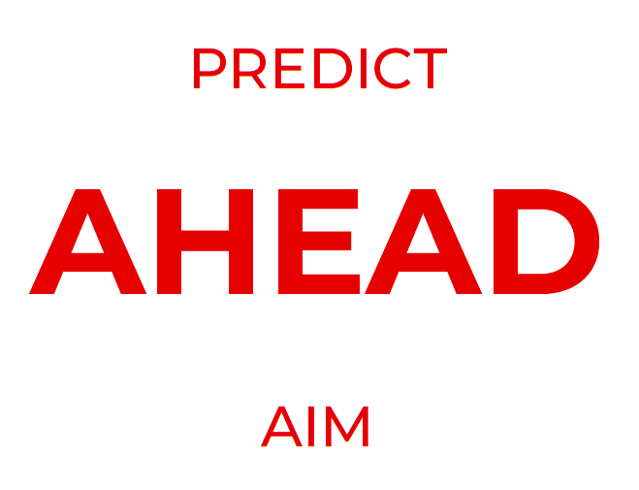
Notes:
ASSEMBLY SLIDE
This is a / the ‘lead in’ slide, which could be used just to flag up the Move of the week / fortnight. It is not an exercise in itself, but could be used for immediate consideration, e.g. with a general question for discussion, such as ‘When is it important to think ahead?’
If the students have not yet seen any of the TM ideograms (n.b. easier to call them icons) you might pause to check that they all see the CONNECTION between the Move and the icon.
By the way, in the teachers’ notes, whenever a Move is mentioned, it is written in capital letters. This demonstrates how commonly we use the Move, but it could also enable you to draw the students’ attention to the Move, as part of a natural way of introducing it. Obviously you can equally point out that CONNECT will be a focus of more attention in fortnight 2, and EXPLAIN in fortnight 3. In so doing, you are asking the students to look / think AHEAD!
Finally – an advanced point: AHEAD is one of 10 Moves that have what we call ‘divergent’ meanings. That is to say, although predict and aim are clearly examples of thinking AHEAD, there is a significant difference between them. To predict is to anticipate a natural event, in which the predictor may play no part – e.g. the weather. But to aim is to hope (with some degree of expectation) for an event or outcome that one is intending to play a part in bringing about. In the A – Z book, for simplicity of presentation, we do not DIVIDE or distinguish these synonyms; and you may decide not to draw attention to the distinction at this stage. But if / when you think your students can cope with this subtlety, do ZOOM IN on it. That would make sure they are thinking about their thinking (Moves), and not just learning new words because the teacher is expecting them to remember them.

Slide 24
(Think) AHEAD Preparing
Either: Imagine you’re about to spend a whole day on this beach. What kind of things might you need to take with you?
Or: If you were to have a day out somewhere, where would you go to?
What would you need to take for your special day out?
Share your thoughts in a conversation with your neighbour.
Notes:
EVERYDAY ACTIVITY 1
After the conversations, explain that the main point of this exercise (apart from developing conversation skills - involving other particular Moves such as LISTEN & RESPOND, and perhaps QUESTION and GROUP, or SIZING how many, etc.) is to WEIGH UP how important thinking AHEAD can be in everyday life.
You might begin, of course, by asking how important it is to prepare for particular days out, or for holidays, and there might be some helpful anecdotes about times when students or their families did not think AHEAD well enough. But try to get the students to CONNECT to other occasions in their everyday life when it is especially important to think AHEAD.
You could even encourage them to assess their own current competence or strength at thinking AHEAD and preparing. Let them do this in pairs first, saying, ‘How good do you think you are at being prepared? – tell your neighbour privately.’ Then, indicating that probably no one is perfectly prepared in life, you could nevertheless ask if it is possible to become more prepared, and, if so, how.

Slide 25
Notes:
ASSEMBLY SLIDE

Slide 26
(Think) BACK Recalling
Ignoring things you do in school, (Think) BACK and tell your partner:
Something you do every single day.
Something you do just once a week
Something you do just once each year
Something you’ve only done once in your whole life
Now try thinking BACK to something you do every day/week/year that you have to do, something that you like to do and something that you would like to do that you don’t do, or haven’t done, yet.
Notes:
EVERYDAY ACTIVITY 1
Whilst this is likely to be an exercise done in school, it is important that we get the message across that Thinking Moves is not just for the classroom, so encourage students to think BACK on their lives outside school. This could also be an activity for students to take home and discuss with parents/carers/siblings.
This can easily be used for an assembly, simply asking students to think-pair-share.
If used in the classroom, results might be collated on the board for further reflection, where students might suggest patterns, CONNECT activities together and/or GROUP them in a range of ways.
As with Preparing / Preparation, try to end by drawing out the value of Recalling / Recollection / Reflection in everyday life, and invite students to assess their own current competence or strength at thinking BACK and reflecting. Let them do this in pairs first, saying, ‘How good do you think you are at reflecting? – tell your neighbour privately.’ Finally, ask if it is possible to become more reflective, and, if so, how.

Slide 27
Notes:
ASSEMBLY SLIDE

Slide 28
CONNECT
Try these at home. How many different ways can you CONNECT:
Birthdays and Christmas
Beds and sofas
Birds and aeroplanes
Televisions and computers
Space rockets and frogs
Notes:
EVERYDAY ACTIVITY 1
This is a creative thinking activity, looking for connections. Encourage students to look for increasingly creative connections and this will help them do the same across the curriculum – how many ways can you find to CONNECT the Vikings with the Victorians, multiplication and division or netball and football, for example.
This can be an activity at home, across the dinner table maybe, using any two objects found in the room. Home activities are best if they are simple, fun and challenging.
The challenge increases when connections between things that appear totally different – like space rockets and frogs – are attempted.

Slide 29
Notes:
ASSEMBLY SLIDE

Slide 30
DIVIDE
Word play
What is the difference between the word ‘play’ in each of these sentences?
I’m going to play with my friend
Listen, I’m going to play you a song
I play the trumpet
I’ll play about with these suggestions and see what I come up with
I went to see a play yesterday
Manchester United are going to play Liverpool on Saturday
I’d like you to play your part in this next activity
Try using a different word to ‘play’ in each of the sentences to help. Can you list all the different meanings of play?
Notes:
IMMEDIATE PRACTICE ACTIVITY 1
Try this out when you have a few minutes to spare

Slide 31
NOTICE
LISTEN/LOOK
GATHER
Notes:
ASSEMBLY SLIDE

Slide 32
LISTEN/LOOK Immediate practice activity
This tells me that…
We often use our senses without even thinking about it but the Thinking Move LISTEN/LOOK asks us to use them deliberately and to think about what they are telling us.
As you walk around school today, or at home, pick one of your senses and try to work out what it is telling you.
For example, if you pick your sense of smell (but not your nose!), and you smell food, what does that tell you? If you smell no food, what does that tell you?
Try feeling inside your bag. What is your sense of touch telling you?
Listen to the sounds around you. What is your sense of hearing telling you?
Notes:
IMMEDIATE PRACTICE ACTIVITY 1
Take the opportunity occasionally in class to ask students to think what their senses are telling them and to ask them which senses might be useful in various activities.

Slide 33
Notes:
ASSEMBLY SLIDE
Slide to highlight the Thinking Move of the week

Slide 34
ZOOM Immediate practice activity
We use both ZOOM (in) and ZOOM (out) every day, often without even realising it. Take a look at this magazine cover.
Do you find yourself zooming out to look at the whole page and then zooming in on particular details?
Try zooming out even further. What do you think the ‘big picture’ message of this magazine might be?
Look at other magazines or books you read – what are their ‘big pictures’?
Notes:
IMMEDIATE PRACTICE ACTIVITY 1
Ask students what encouraged them to ZOOM in on particular aspects. For example, it might have been a colourful text box, a smiling face or a single highlighted word. They can then draw upon this when creating their own posters/information leaflets.

